Slide 1
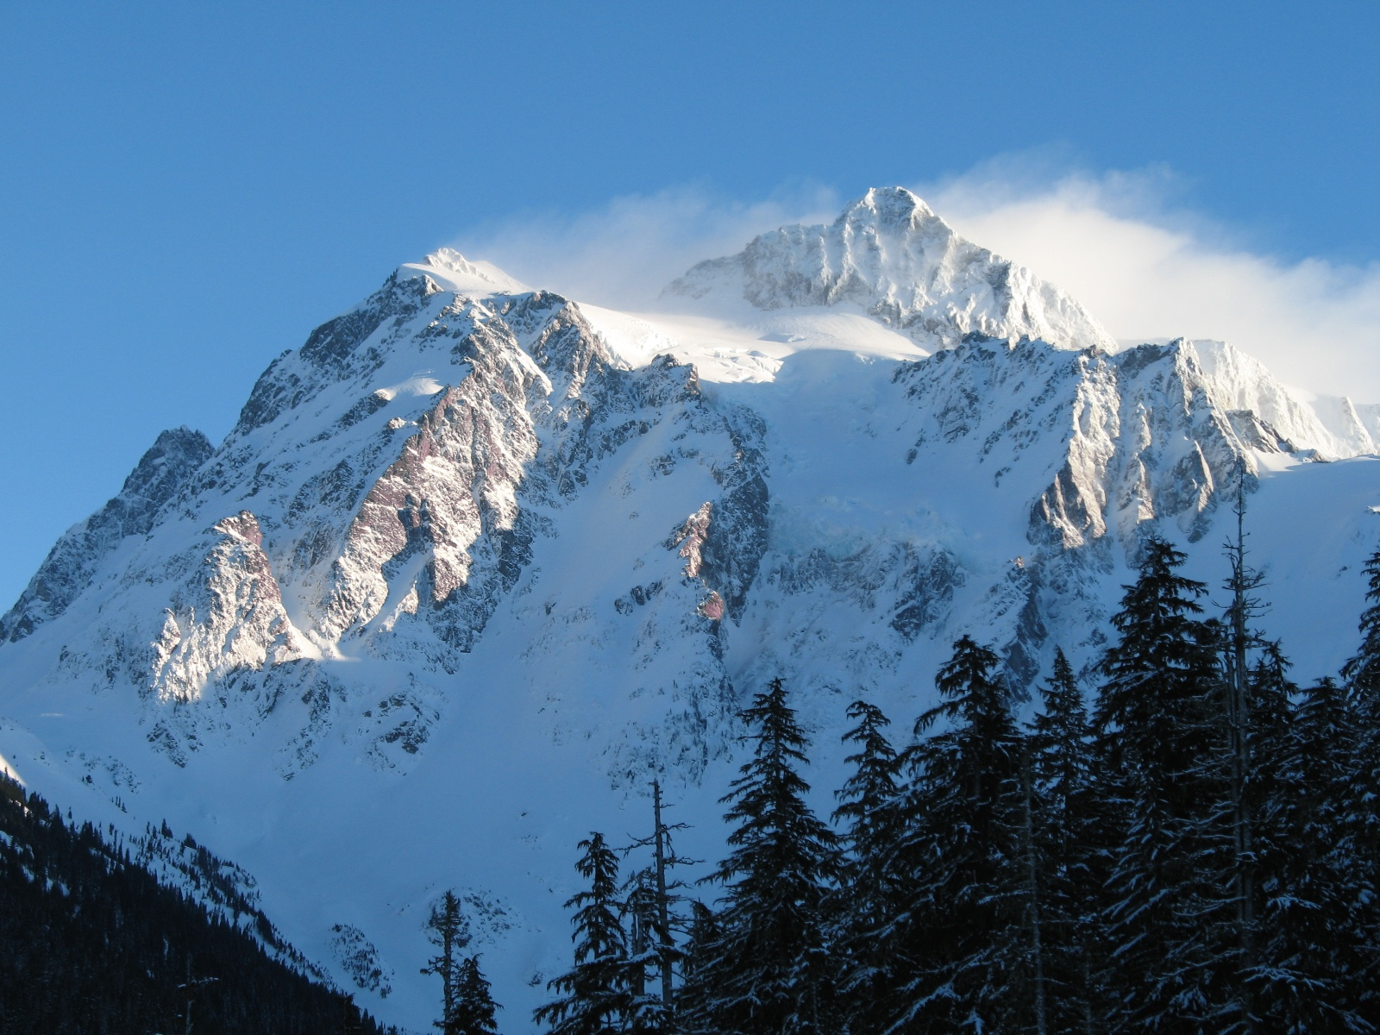
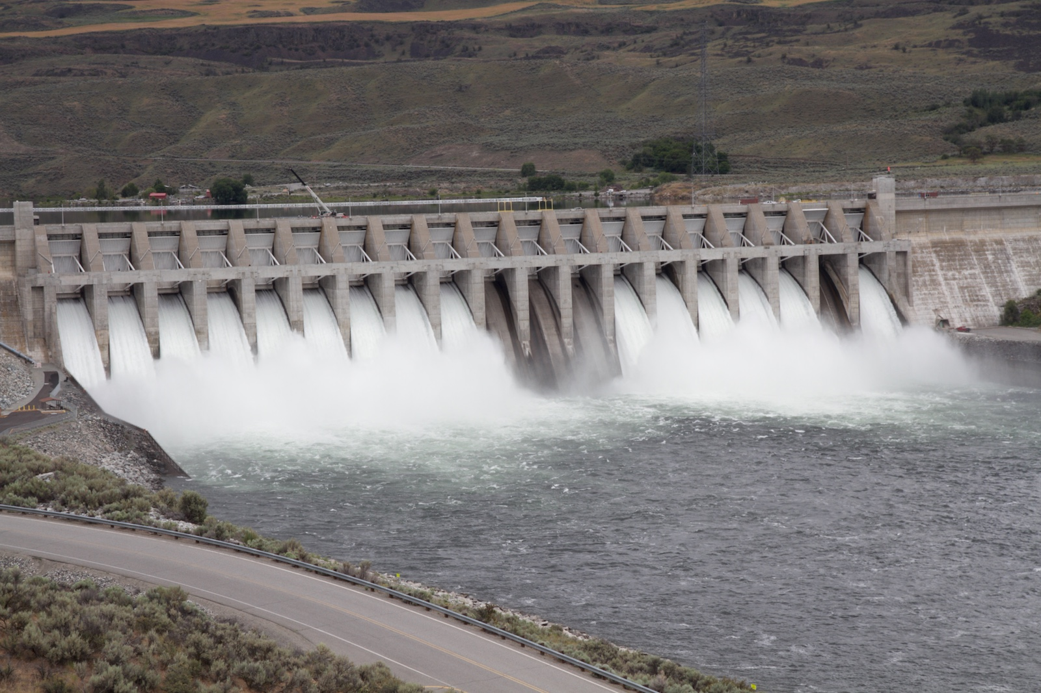
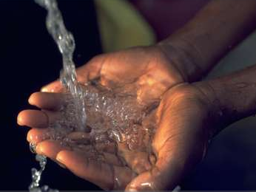


Hydrologic sensitivities
Julie Vano
Research while at:
University of Washington
Oregon State University
Key Collaborators: Dennis Lettenmaier (UCLA), Phil Mote (OSU),
Bart Nijssen (UW), Alan Hamlet (Notre Dame), David Rupp (OSU)
June 21, 2016
Meeting at U.S. Army Corps of Engineers, Seattle District Office
Notes:
1

Slide 2
What are hydrologic sensitivities?

Slide 3
Precipitation
Elasticity (ε)
Q _{ref+Δ%} - Q_{ref}
=
Q_{ref}
Δ%
Q _{ref+Δ} - Q_{ref}
Temperature
Sensitivity (S)
=
Q_{ref}
Δ°C
Notes:
temperature (additive) and precipitation (percentage)

Slide 4
How are hydrologic sensitivities useful?

Slide 5
1. Help explain how hydrology models differ

Slide 6
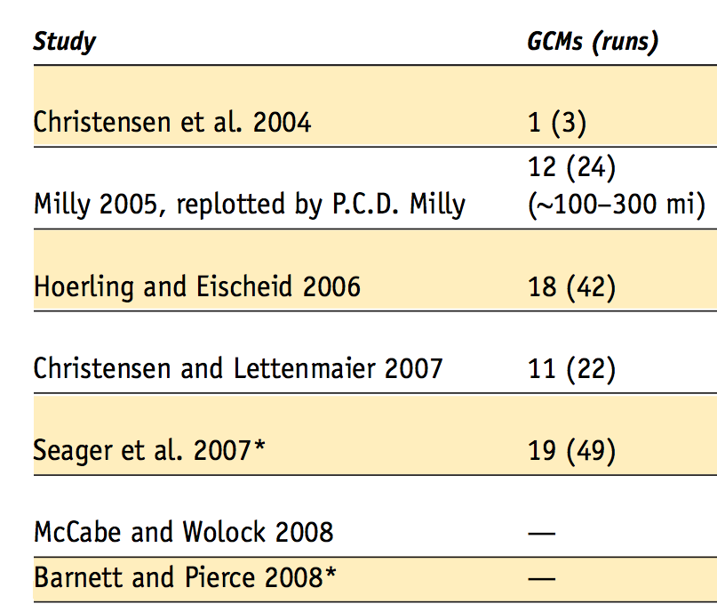
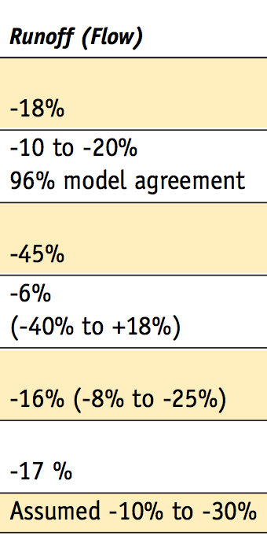
Colorado River flows, mid 21st Century
Information from Table 5-1 in Western Water Assessment report to the Colorado Water Conservation Board “Colorado Climate Change: A Synthesis to Support Water Resource Management and Adaptation.” Oct 2008 (available online at: http://cwcb.state.co.us/NR/rdonlyres/8118BBDB-4E54-4189-A354-3885EEF778A8/0/CCSection5.pdf)
6

Slide 7
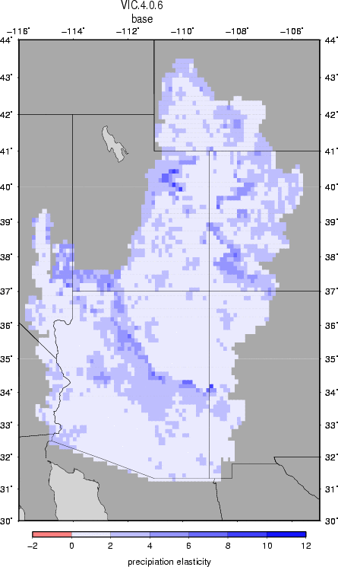
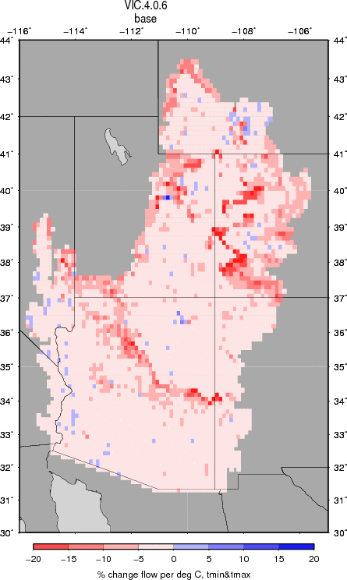
Spatial Hydrologic Sensitivities for VIC
Lees
Ferry
Lees
Ferry
Q _{ref+1%} - Q_{ref}
Q _{ref+0.1°C} - Q_{ref}
Precipitation
Elasticity (ε)
=
Temperature
Sensitivity (S)
=
Q_{ref}
Q_{ref}
1%
0.1 °C
At Lees Ferry for the historical reference period:
ε= 2.2 and S = 6.5% per °C
Figure from Vano et al., JHM, 2012

Slide 8
Spatial Hydrologic Sensitivities for Six Land Surface Models

Slide 9
Approaches to generating future streamflow projections
Studies using various approaches:
Seager et al. 2007; Seager et al. 2013
Milly et al. 2005
Christensen et al. 2004; Christensen and Lettenmaier, 2007; Cayan et al. 2010; USBR 2011
Gao et al. 2011; Rasmussen et al. 2011
Gao et al. 2012
Hoerling and Eischeid 2007
Cook et al. 2004
Woodhouse et al. 2006; McCabe and Wolock 2007; Meko et al. 2007; USBR 2011
Abbreviations:
GCM – Global Climate Model
RCM – Regional Climate Model
PDSI – Palmer Drought Severity Index
P – Precipitation
T – Temperature
R – Runoff
E – Evaporation
S. downscaling – statistical downscaling
GCMs, Emission scenarios,
Spatial resolution
Land surface representation
Figure from Vano et al., BAMS, 2014

Slide 10
2. Provide quick calculations of long-term average changes, annually and seasonally

Slide 11
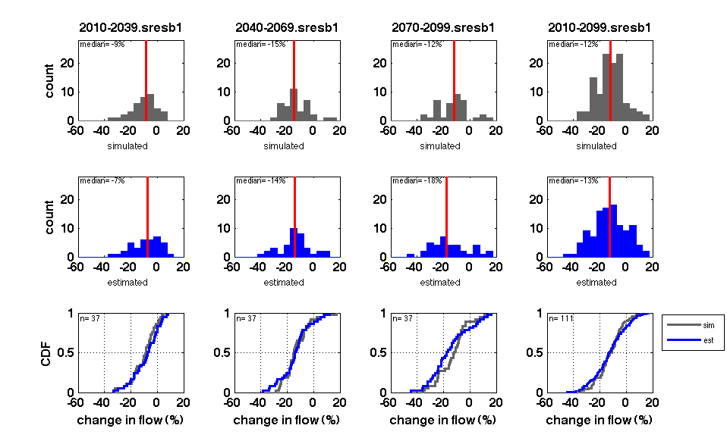
Current approach:
Full-simulation approach
Quick approach:
Sensitivity-based approach
Global Climate
Model (P_{GCM},T_{GCM})
Global Climate
Model (ΔP_{GCM},ΔT_{GCM})
bias correcting,
downscaling
Hydrology
Models (e.g., VIC)
Hydrology
Sensitivities (ε,S)
stream routing,
bias correcting
Future
streamflow
Future streamflow
change (ΔQ_{est})
Colorado R. at Lee’s Ferry in 2050s
Colorado R. at Lee’s Ferry in 2050s
?
count
count
% change in annual streamflow
% change in annual streamflow

Slide 12
Future scenarios: Long-term annual average
Full-simulation
approach
dQ_{sim} = (Q_{sim}-Q_{hist})/Q_{hist}
Sensitivity-based
approach
dQ_{est} = ΔT_{GCM}*Tsensivity+ ΔP_{GCM}*Pelastcity + d(T,P)interaction (with 3 adjust.)
Comparison of approaches for LONG-TERM annual change in
streamflow (Q)

Slide 13
2010-2039
2040-2069
2070-2099
B1 CDF
A1B CDF
A2 CDF
A2
Sensitivity-based approach
Full-simulation approach
Cumulative distribution functions (CDFs) of 112 USBR simulations divided into time periods and emission scenarios.

Slide 14
Current approach:
Full-simulation approach
Quick approach:
Sensitivity-based approach
Global Climate
Model (P_{GCM},T_{GCM})
Global Climate
Model (ΔP_{GCM},ΔT_{GCM})
bias correcting,
downscaling
Hydrology
Models (e.g., VIC)
Hydrology
Sensitivities (ε,S)
stream routing,
bias correcting
Future
streamflow
Future streamflow
change (ΔQ_{est})
Yakima River naturalized flow (A1B)
?

Slide 15
Yakima River basin at Parker
Data from full-simulations were provided by Columbia Basin Climate Change Scenarios Project, UW, http://www.hydro.washington.edu/2860/.
Notes:
I think units are cfs

Slide 16
Yakima River basin at Parker
Data from full-simulations were provided by Columbia Basin Climate Change Scenarios Project, UW, http://www.hydro.washington.edu/2860/.

Slide 17
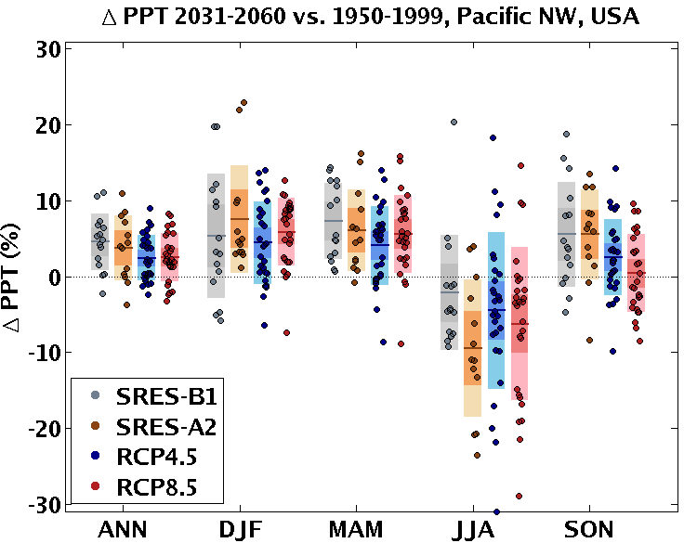
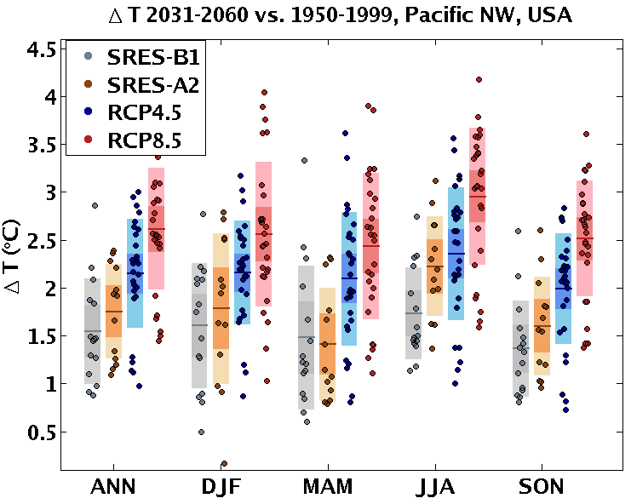
New Climate Change Projections
Precipitation
Temperature
How does this translate into changes in streamflow?
Figures from John Abataoglou at the University of Idaho

Slide 18
New Climate Change Projections
Precipitation
Temperature
2007 GCMs
How does this translate into changes in streamflow?
Figures from John Abataoglou at the University of Idaho

Slide 19
New Climate Change Projections
Precipitation
Temperature
2007 GCMs
2012 GCMs
How does this translate into changes in streamflow?
Figures from John Abataoglou at the University of Idaho

Slide 20
Yakima River Basin, streamflow estimates in 2050s
2007 GCMs
2012 GCMs
n=15
n=13
n=27
n=27
N=15
n is the number of GCMs for each emission scenario, preliminary results.

Slide 21
3. Help in selecting global climate models for a particular impact

Slide 22

Lots of models, increasingly more information, impacts only considered at the end
Image from http://www.activatedesign.co.nz/blog/the-frustration-of-almost-perfect-websites/

Slide 23
Are there ways to understand climate change impacts that are less computationally involved and focus on the impact you care most about?

Slide 24
Good news, there is…
Not all models are created equal; we can be more selective in what we use

Slide 25
Global Climate Model ranking for
Pacific Northwest by Rupp et al. JGR 2013

Slide 26
Good news, there is…
Not all models are created equal; we can be more selective in what we use
Sensitivities of a particular impact (e.g., streamflow change) can provide plausible first-order estimates and aid model selection

Slide 27
Global Climate Models precipitation and temperature responses
GCM ranking from Rupp et al. (JGR 2013), blue = RCP 4.5, red = RCP 8.5, Eastern Washington region 1970-1999 to 2041-2070
Notes:
Use sensitivity as simple linear model
dF=a dT + b dP also dF=const. -a/b
(slope is elast / sensitivity)

Slide 28
Global Climate Models precipitation and temperature responses
warmer,
drier
warmer,
wetter
less warm,
drier
less warm,
wetter
GCM ranking from Rupp et al. (JGR 2013), blue = RCP 4.5, red = RCP 8.5, Eastern Washington region 1970-1999 to 2041-2070
Notes:
Use sensitivity as simple linear model
dF=a dT + b dP also dF=const. -a/b
(slope is elast / sensitivity)

Slide 29
Impact:
Seasonal Streamflow
Upper Columbia
Spring snowmelt
(April-June)
Yakima
Irrigation season
(April-September)
Willamette
Summer flows for fish
(June-August)

Slide 30
Q _{ref+Δ°C} - Q_{ref}
Temperature
Sensitivity (S)
=
Q_{ref}
Δ°C
Yakima
Irrigation season
(April-September)
Vano, Kim, Rupp, and Mote, GRL, 2015.
Notes:
Temperature: Summer in Willamette and Apr-Sep in Yakima, as temperatures increase, the decline per deg C becomes less (can only decrease streamflow by so much)
Spring in the Upper Columbia, temperatures result in flow increases (for smaller T changes), but once T changes are large the shift in the hydrograph is so big that flows in AMJ decline
Precipitation: In the Upper Columbia, if we used the 1% perturbation instead of 20% and the change in P was 20%, we'd estimate a streamflow change of 21.6% instead of 20.2%. Alternatively, for T, if we used a 0.1 deg C instead of a 3 deg C and the change in temp was 3 deg C, we'd estimate a 21.6% change instead of a 5.5%.
In the Upper Columbia, if we used the 1% perturbation instead of 20% and the change in P was 20%, we'd estimate a streamflow change of 21.6% instead of 20.2%. Alternatively, for T, if we used a 0.1 deg C instead of a 3 deg C and the change in temp was 3 deg C, we'd estimate a 21.6% change instead of a 5.5% (and it gets worse if I calc it for a 6 deg C change, 43.2% vs. -15.0%, where the sign actually changes).
Summer in Willamette and Apr-Sep in Yakima, as temperatures increase, the decline per deg C becomes less (can only decrease streamflow by so much)
Spring in the Upper Columbia, temperatures result in flow increases (for smaller T changes), but once T changes are large the shift in the hydrograph is so big that flows in AMJ decline

Slide 31
Q _{ref+Δ°C} - Q_{ref}
Temperature
Sensitivity (S)
=
Q_{ref}
Δ°C
Yakima
Irrigation season
(April-September)
Vano, Kim, Rupp, and Mote, GRL, 2015.
Notes:
Temperature: Summer in Willamette and Apr-Sep in Yakima, as temperatures increase, the decline per deg C becomes less (can only decrease streamflow by so much)
Spring in the Upper Columbia, temperatures result in flow increases (for smaller T changes), but once T changes are large the shift in the hydrograph is so big that flows in AMJ decline
Precipitation: In the Upper Columbia, if we used the 1% perturbation instead of 20% and the change in P was 20%, we'd estimate a streamflow change of 21.6% instead of 20.2%. Alternatively, for T, if we used a 0.1 deg C instead of a 3 deg C and the change in temp was 3 deg C, we'd estimate a 21.6% change instead of a 5.5%.
In the Upper Columbia, if we used the 1% perturbation instead of 20% and the change in P was 20%, we'd estimate a streamflow change of 21.6% instead of 20.2%. Alternatively, for T, if we used a 0.1 deg C instead of a 3 deg C and the change in temp was 3 deg C, we'd estimate a 21.6% change instead of a 5.5% (and it gets worse if I calc it for a 6 deg C change, 43.2% vs. -15.0%, where the sign actually changes).

Slide 32
Q _{ref+Δ°C} - Q_{ref}
Temperature
Sensitivity (S)
=
Q_{ref}
Δ°C
Yakima
Irrigation season
(April-September)
Willamette
Summer flows for fish
(June-August)
Vano, Kim, Rupp, and Mote, GRL, 2015.
Notes:
Temperature: Summer in Willamette and Apr-Sep in Yakima, as temperatures increase, the decline per deg C becomes less (can only decrease streamflow by so much)
Spring in the Upper Columbia, temperatures result in flow increases (for smaller T changes), but once T changes are large the shift in the hydrograph is so big that flows in AMJ decline
Precipitation: In the Upper Columbia, if we used the 1% perturbation instead of 20% and the change in P was 20%, we'd estimate a streamflow change of 21.6% instead of 20.2%. Alternatively, for T, if we used a 0.1 deg C instead of a 3 deg C and the change in temp was 3 deg C, we'd estimate a 21.6% change instead of a 5.5%.
In the Upper Columbia, if we used the 1% perturbation instead of 20% and the change in P was 20%, we'd estimate a streamflow change of 21.6% instead of 20.2%. Alternatively, for T, if we used a 0.1 deg C instead of a 3 deg C and the change in temp was 3 deg C, we'd estimate a 21.6% change instead of a 5.5% (and it gets worse if I calc it for a 6 deg C change, 43.2% vs. -15.0%, where the sign actually changes).

Slide 33
Q _{ref+Δ°C} - Q_{ref}
Temperature
Sensitivity (S)
=
Q_{ref}
Δ°C
Upper Columbia
Spring snowmelt
(April-June)
Yakima
Irrigation season
(April-September)
Willamette
Summer flows for fish
(June-August)
Vano, Kim, Rupp, and Mote, GRL, 2015.
Notes:
Temperature: Summer in Willamette and Apr-Sep in Yakima, as temperatures increase, the decline per deg C becomes less (can only decrease streamflow by so much)
Spring in the Upper Columbia, temperatures result in flow increases (for smaller T changes), but once T changes are large the shift in the hydrograph is so big that flows in AMJ decline
Precipitation: In the Upper Columbia, if we used the 1% perturbation instead of 20% and the change in P was 20%, we'd estimate a streamflow change of 21.6% instead of 20.2%. Alternatively, for T, if we used a 0.1 deg C instead of a 3 deg C and the change in temp was 3 deg C, we'd estimate a 21.6% change instead of a 5.5%.
In the Upper Columbia, if we used the 1% perturbation instead of 20% and the change in P was 20%, we'd estimate a streamflow change of 21.6% instead of 20.2%. Alternatively, for T, if we used a 0.1 deg C instead of a 3 deg C and the change in temp was 3 deg C, we'd estimate a 21.6% change instead of a 5.5% (and it gets worse if I calc it for a 6 deg C change, 43.2% vs. -15.0%, where the sign actually changes).

Slide 34
Varying temperature response
Vano, Kim, Rupp, and Mote, GRL, 2015.
Notes:
Temperature: Summer in Willamette and Apr-Sep in Yakima, as temperatures increase, the decline per deg C becomes less (can only decrease streamflow by so much)
Spring in the Upper Columbia, temperatures result in flow increases (for smaller T changes), but once T changes are large the shift in the hydrograph is so big that flows in AMJ decline
Precipitation: In the Upper Columbia, if we used the 1% perturbation instead of 20% and the change in P was 20%, we'd estimate a streamflow change of 21.6% instead of 20.2%. Alternatively, for T, if we used a 0.1 deg C instead of a 3 deg C and the change in temp was 3 deg C, we'd estimate a 21.6% change instead of a 5.5%.
In the Upper Columbia, if we used the 1% perturbation instead of 20% and the change in P was 20%, we'd estimate a streamflow change of 21.6% instead of 20.2%. Alternatively, for T, if we used a 0.1 deg C instead of a 3 deg C and the change in temp was 3 deg C, we'd estimate a 21.6% change instead of a 5.5% (and it gets worse if I calc it for a 6 deg C change, 43.2% vs. -15.0%, where the sign actually changes).

Slide 35
and constant precipitation response
Varying temperature response
Vano, Kim, Rupp, and Mote, GRL, 2015.
Notes:
Temperature: Summer in Willamette and Apr-Sep in Yakima, as temperatures increase, the decline per deg C becomes less (can only decrease streamflow by so much)
Spring in the Upper Columbia, temperatures result in flow increases (for smaller T changes), but once T changes are large the shift in the hydrograph is so big that flows in AMJ decline
Precipitation: In the Upper Columbia, if we used the 1% perturbation instead of 20% and the change in P was 20%, we'd estimate a streamflow change of 21.6% instead of 20.2%. Alternatively, for T, if we used a 0.1 deg C instead of a 3 deg C and the change in temp was 3 deg C, we'd estimate a 21.6% change instead of a 5.5%.
In the Upper Columbia, if we used the 1% perturbation instead of 20% and the change in P was 20%, we'd estimate a streamflow change of 21.6% instead of 20.2%. Alternatively, for T, if we used a 0.1 deg C instead of a 3 deg C and the change in temp was 3 deg C, we'd estimate a 21.6% change instead of a 5.5% (and it gets worse if I calc it for a 6 deg C change, 43.2% vs. -15.0%, where the sign actually changes).

Slide 36
Global Climate Models precipitation and temperature changes
GCM ranking from Rupp et al. (JGR 2013), blue = RCP 4.5, red = RCP 8.5, lighter numbers indicate multiple runs for the same GCM, Eastern Washington region 1970-1999 to 2041-2070
Notes:
Use sensitivity as simple linear model
dF=a dT + b dP also dF=const. -a/b
(slope is elast / sensitivity)

Slide 37
Global Climate Models precipitation and temperature changes
and selection based on impact-relevant sensitivities
Yakima River basin
irrigation season
(Apr-Sep)
GCM ranking from Rupp et al. (JGR 2013), blue = RCP 4.5, red = RCP 8.5, lighter numbers indicate multiple runs for the same GCM, Eastern Washington region 1970-1999 to 2041-2070, contours of streamflow change derived from S and ε values
Notes:
Use sensitivity as simple linear model
dF=a dT + b dP also dF=const. -a/b
(slope is elast / sensitivity)

Slide 38
Global Climate Models precipitation and temperature changes
and selection based on impact-relevant sensitivities
Yakima River basin
irrigation season
(Apr-Sep)
GCM ranking from Rupp et al. (JGR 2013), blue = RCP 4.5, red = RCP 8.5, lighter numbers indicate multiple runs for the same GCM, Eastern Washington region 1970-1999 to 2041-2070, contours of streamflow change derived from S and ε values
Notes:
Use sensitivity as simple linear model
dF=a dT + b dP also dF=const. -a/b
(slope is elast / sensitivity)

Slide 39
Selecting climate scenarios in three river basins and seasons
Contours based on Variable Infiltration Capacity hydrologic model derived sensitivities, fig. from Vano et al., GRL, 2015
Notes:
good performers, meaning they adequately simulate historical climate, providing plausible results for the region of interest

Slide 40
4. Help explain how future projections differ for the impact of interest
Note: as long as impacts are long-term seasonal (also shown earlier) or annual averages

Slide 41
Impact distributions for specific seasons
Streamflow
change
= S(ΔT) ΔT + ε ΔP
Willamette
Summer flows for fish
(June-August)
Yakima
Irrigation season
(April-September)
Upper Columbia
Spring snowmelt
(April-June)
% streamflow change
% streamflow change
% streamflow change
Vano, Kim, Rupp, and Mote, GRL, 2015.

Slide 42
Preliminary Results at Lees Ferry, Sensitivity-based approach estimation for AR5 GCMs
2010-2039
2040-2069
2070-2099
N=24
RCP 26
N=35
RCP 45
N=17
RCP 60
N=32
One run per GCM
RCP 85
change in streamflow (%), difference relative to 1970-1999

Slide 43
Preliminary Results, Sensitivity-based approach estimation for AR5 GCMs
2010-2039
2040-2069
2070-2099
N=50
RCP 26
N=67
RCP 45
N=33
RCP 60
N=65
All runs per GCM
RCP 85
change in streamflow (%), difference relative to 1970-1999

Slide 44
What are hydrologic sensitivities limitations?

Slide 45
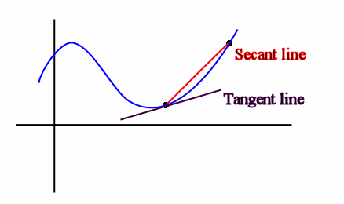
Considerations
Linearity, the extent to which a small change (e.g., 0.1 °C), which provides a reasonable approximation of the tangent of the change, is proportional to a larger change (e.g., 3 °C) which captures the secant
(2) Superposition, the extent to which hydrologic sensitivities identified through independent simulations can be added together to equal the same value as changes applied within the same simulation.
?
ΔQ_{1%P}+ΔQ_{1°C}= ΔQ_{1°C & 1%P}
?
ΔQ_{3°C warm season}+ ΔQ_{3°C cool season} = ΔQ_{3°C year round}

Slide 46
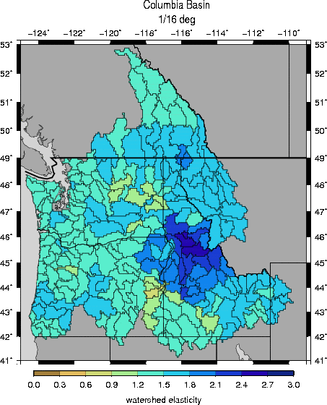
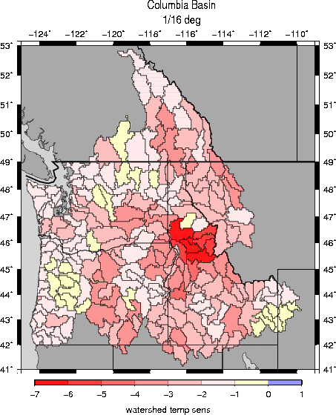
(3) Considerations: Physical context
Precipitation
Elasticity, ε
Temp. Sensitivity, S
(% runoff change per °C)
ε:
S:

Slide 47
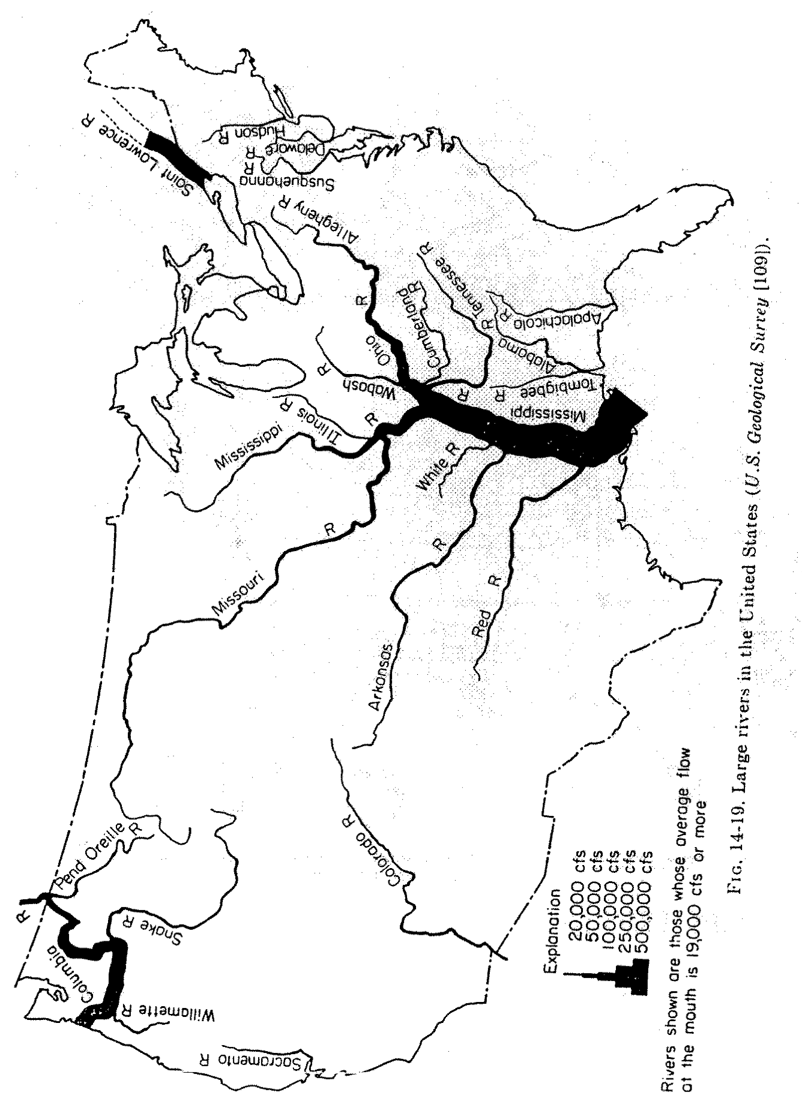
(4) Considerations: Management context
0.3
Annual vs. seasonal responses
4
total storage relative to annual inflow ratios
Figure from Steve Burges, CEE 576, Physical Hydrology, Fall 2007

Slide 48
Hydrologic sensitivities are a measure of long-term average changes. They cannot be used to evaluate extremes or used in reservoir operations modeling (or any evaluation that relies on a temporal sequence).

Slide 49
Summary
How are hydrologic sensitivities useful:
Help explain how hydrology models differ
Provide quick calculations of long-term average changes, annually and seasonally
Help in selecting global climate model futures for a particular impact
Help explain how future projections differ
What are hydrologic sensitivities limitations:
Ability to use hydrologic sensitivities depends on linearity, superposition, physical and management context (not one size fits all)
Not for evaluating extremes or any evaluation that relies on temporal sequences
Overall:
Quick and complementary, can help set bounds and understand new scenarios
Emphasizes understanding of the system and impact, not just data processing
Notes:
quantify local change through using concepts of hydrologic sensitivities to changes in central tendencies and extreme events.
Are there other approaches to understand climate change impacts that start with the impact?
(ideally ones that are less computationally involved)

Slide 50
Acknowledgements
Thanks to my co-authors, especially Dennis Lettenmaier, Bart Nijssen, Phil Mote, and Alan Hamlet.
Support for this work was provided by the National Science Foundation under Awards No. EAR-1250087 and EAR-1039192, by the U.S. National Oceanic and Atmospheric Administration, Grant NA10OAR4310218, and by USGS, Grant #G12AC20495
Vano, J. A., J. B. Kim, D. E. Rupp, and P. W. Mote (2015), Selecting climate change scenarios using impact-relevant sensitivities, Geophys. Res. Lett., 42, 5516–5525, doi:10.1002/2015GL063208.
Vano, JA, B Nijssen, and DP Lettenmaier, 2015: Seasonal hydrologic responses to climate change in the Pacific Northwest, Water Resources Research, 51(4), 1959-1976, doi:10.1002/2014WR015909
Feedback, questions??

Slide 51
More on seasonal sensitivities

Slide 52
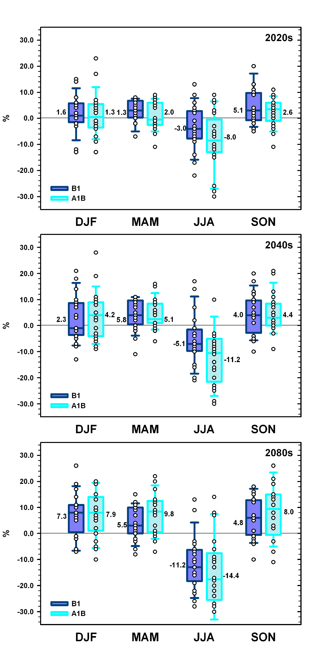
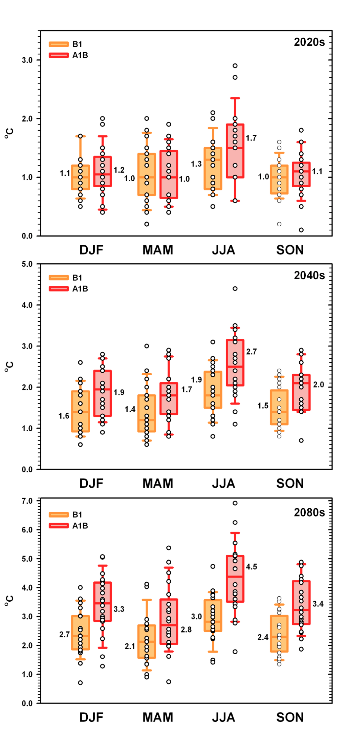
Projected precipitation changes over Pacific Northwest
Temperature
Precipitation
Figure from Mote and Salathé (2009), Washington Climate Change Impacts Assessment.
Notes:
describe what’s shown in more detail (for example, the SRES scenarios, y and x axis, what is the box plot range).
Fig. 9 Range (lowest to highest) of projected changes in temperature for each season (DJF=winter, etc.), relative to the 1970-99 mean. In each pair of box- and-whiskers, the left one is for SRES scenario B1 and the right is A1B; circles are individual model values. Box-and-whiskers plots indicate 10th and 90th percentiles (whiskers), 25th and 75th percentiles (box ends), and median (solid middle bar) for each season and scenario. Not all values are visible due to symbol overlap. Printed values are the weighted Reliability Ensemble Average of all GCMs for the season and scenario.
Fig. 10 As in Figure 9, but for precipitation. The height of the bars indicates actual water precipitation but the percentages are calculated with respect to a reference value for that season, so that -11% in JJA is much less than -11% in DJF. The reference values for the extremes are that model’s 20th century mean for that season (or annual mean), and for the REA average the reference is the all-model 20th century value. Unlike for temperature, for any season some models project increases and some project decreases, though the vast majority project decreases for summer and increases for winter by the 2080s
Over PNW. defined as the region between 124° and 111° west longitude, 41.5° to 49.5° north latitude: Washington, Oregon, Idaho,
western Montana, and a small slice of adjacent states and British Columbia.
Models have different spatial resolutions, but the number of model grid
points enclosed in this latitude-longitude box is between 6 and 91.

Slide 53
Seasonal responses to temperature change
S values:

Slide 54
Seasonal responses to temperature change
S values:

Slide 55
Seasonal responses to temperature change
S values:

Slide 56
Seasonal responses to temperature change
S values:

Slide 57
Seasonal responses to temperature change
S values:

Slide 58
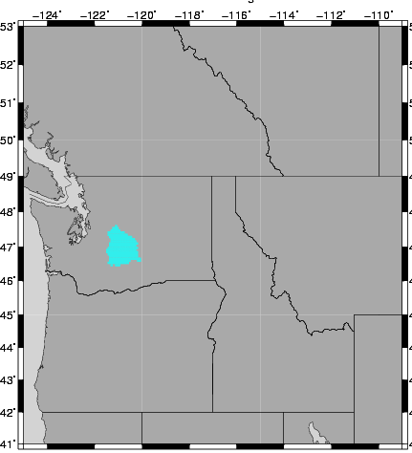
Seasonal Responses Yakima River basin at Parker
S values:
96 values (ε and S) serve as transfer function
ε values:

Slide 59
Seasonal Responses Yakima River basin at Parker
S values:
96 values (ε and S) serve as transfer function
ε values:

Slide 60
Application
Q_{his}+Q_{his}*ΔT_{OND}*S_{OND} = Q₁
Q₁+Q₁*ΔP_{OND}*ε_{OND} = Q₂
Q₂+Q₂*ΔT_{JFM}*S_{JFM} = Q₃
and so on…
Q₃+Q₃*ΔP_{JFM}*ε_{JFM} = Q₄
Q₄+Q₄*ΔT_{AMJ}*S_{AMJ} = Q₅
Q₅+Q₅*ΔP_{AMJ}*ε_{AMJ} = Q₆
Q₆+Q₆*ΔT_{JAS}*S_{JAS} = Q₇
Q₇+Q₇*ΔP_{JAS}*ε_{JAS} = Q_{future_flow}
S values:
ε values:
Sequencing allows for the superposition of 0.1°C, while also capturing the interactions from larger increments of change
Notes:
Want to be able to capture the larger increment of change, but also have them distinct as the temperatures applied would be uniform. Important to capture the interatctions. How change from one season is effecting the other.
Reintroduce some of the effect of the large seasonal shifts without double counting snow melt… ant superposition of 0.1 deg C, but change increment is often greater, in which case it’s important to

Slide 62
2040s for
A1B emissions
Data from full-simulations were provided by Columbia Basin Climate Change Scenarios Project, UW, http://www.hydro.washington.edu/2860/.

Slide 63
New Climate Change Projections
Precipitation
Temperature
2007 GCMs
2012 GCMs
How does this translate into changes in streamflow?
Figures from John Abataoglou at the University of Idaho

Slide 64
Yakima River Basin, streamflow estimates in 2080s
Percent diff is the change in annual magnitude, n is the number of GCMs for each emission scenario.

Slide 65
Yakima River Basin, streamflow estimates in 2080s
ONLY
TEMP
Percent diff is the change in annual magnitude, n is the number of GCMs for each emission scenario.

Slide 66
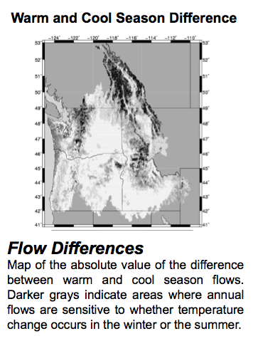
Sub-basin responses to changes in seasonal differences
cool season
warm season
S values:
Differences in warm and cool season responses.
dark orange = largest change in seasonality

Slide 67
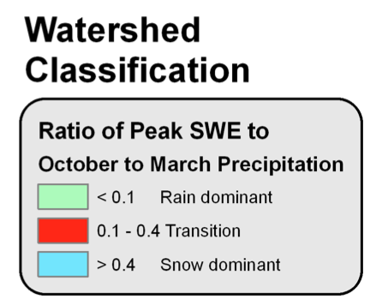
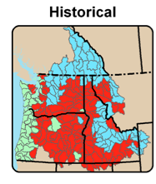
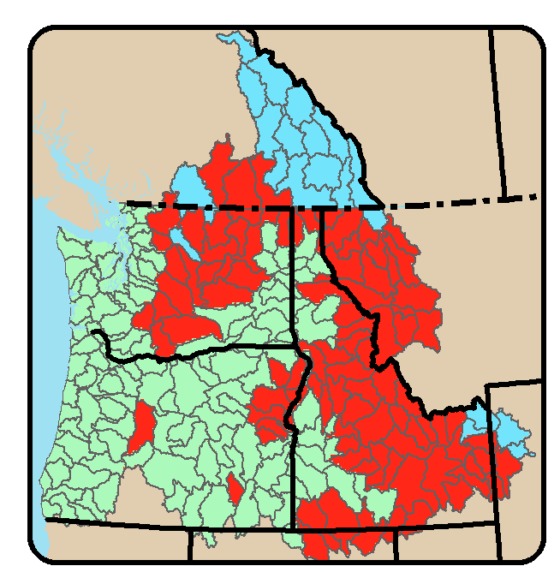
Sub-basin responses to changes in seasonal differences
2080 B1
Differences in warm and cool season responses.
dark orange = largest change in seasonality

Slide 68
More on annual sensitivities

Slide 69
Methodology
Land-surface Hydrologic Models
Measures
Catchment LSM
Community Land
Model 3.5 (CLM)
Noah 2.7 LSM
Noah 2.8 LSM
Sacramento (Sac)
Variable Infiltration
Capacity 4.0.6 (VIC)
Q _{ref+1%} - Q_{ref}
Precipitation
Elasticity (ε)
=
Q_{ref}
1%
Q _{ref+0.1} - Q_{ref}
Temperature
Sensitivity (S)
=
Q_{ref}
0.1°C
Precipitation & Temperature Interactions
Notes:
temperature (additive) and precipitation (percentage)

Slide 70
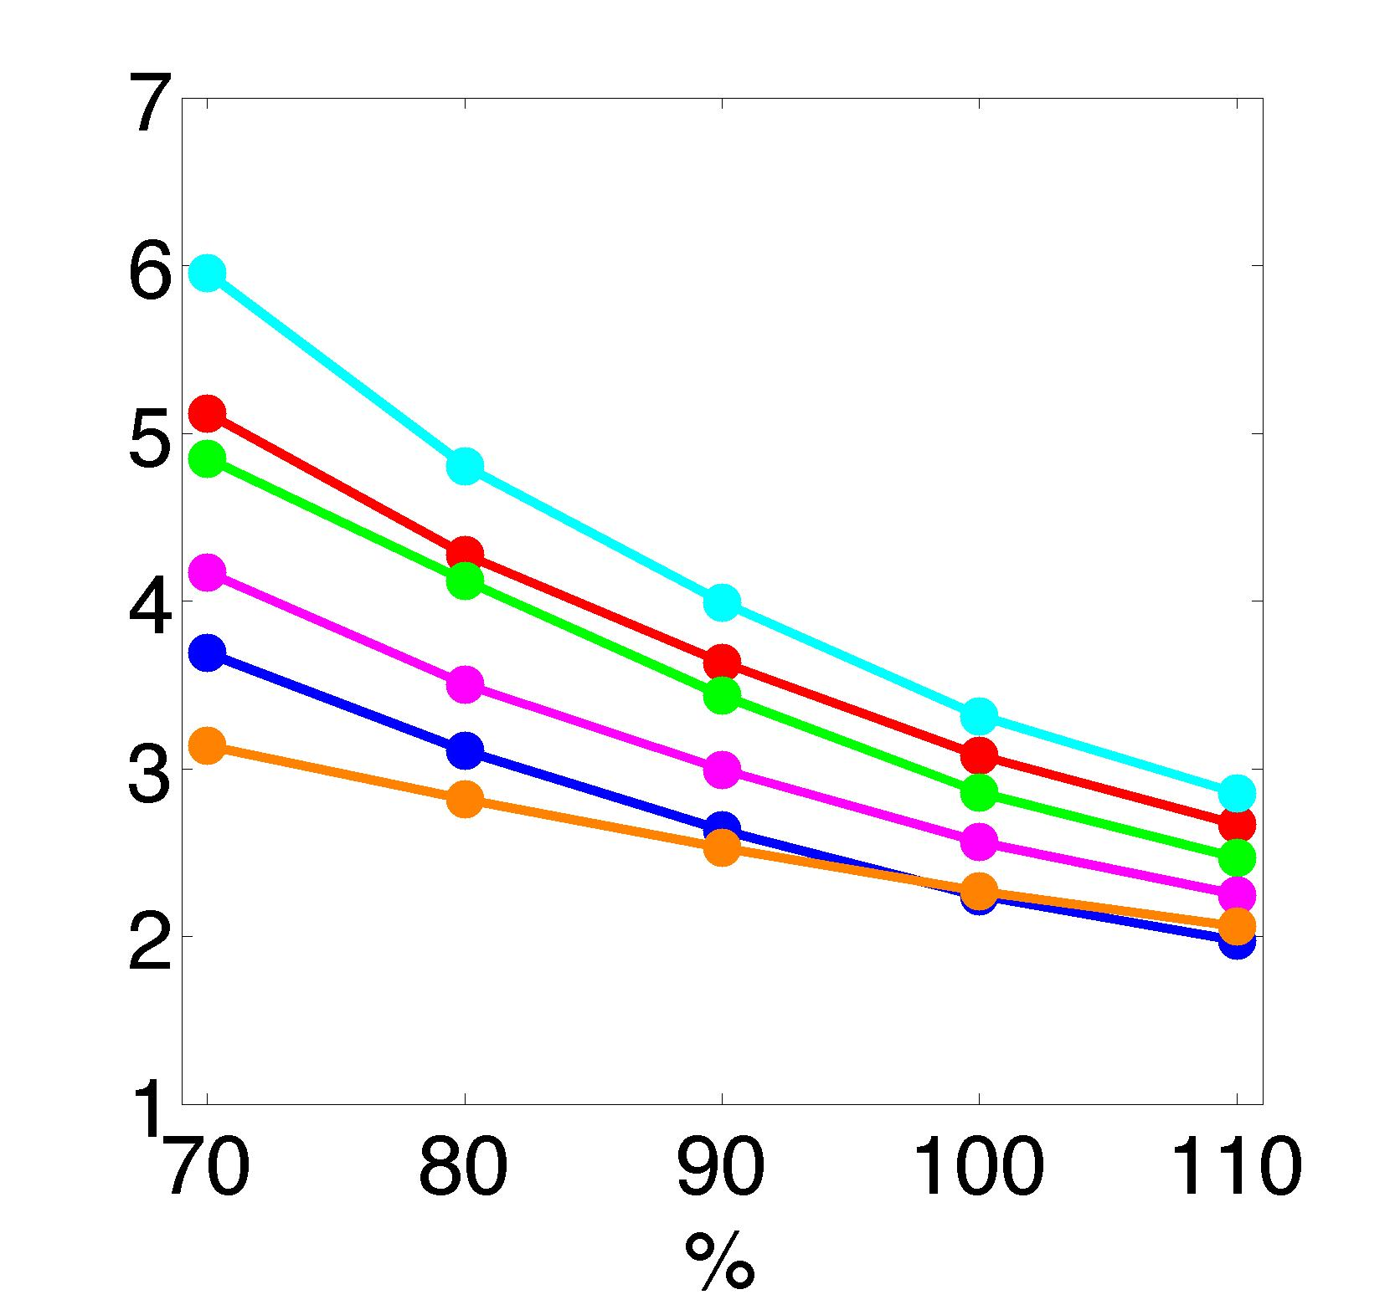
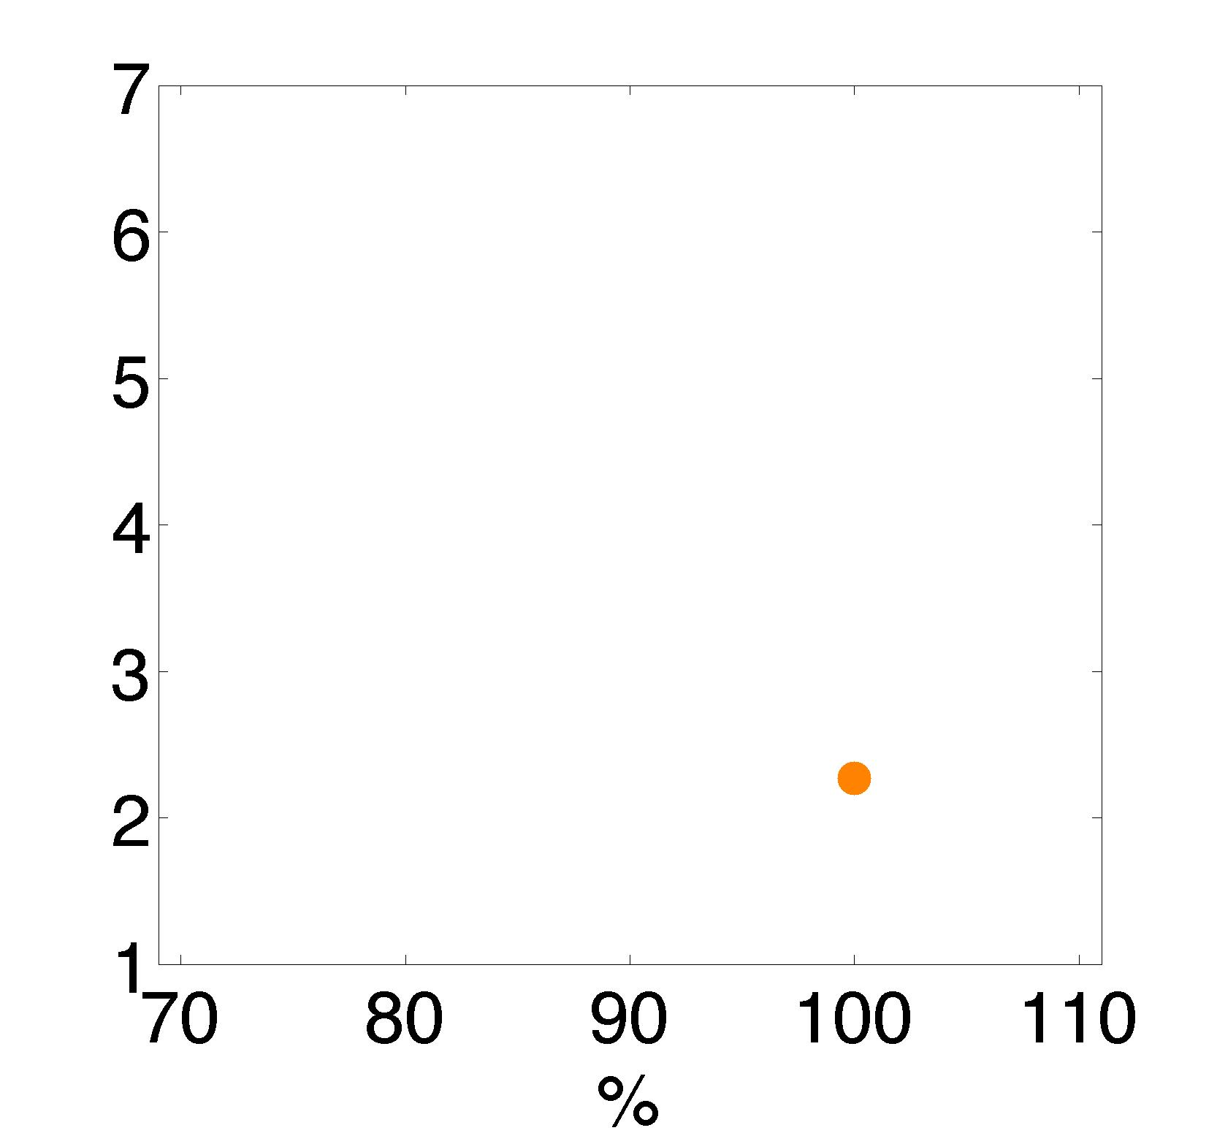
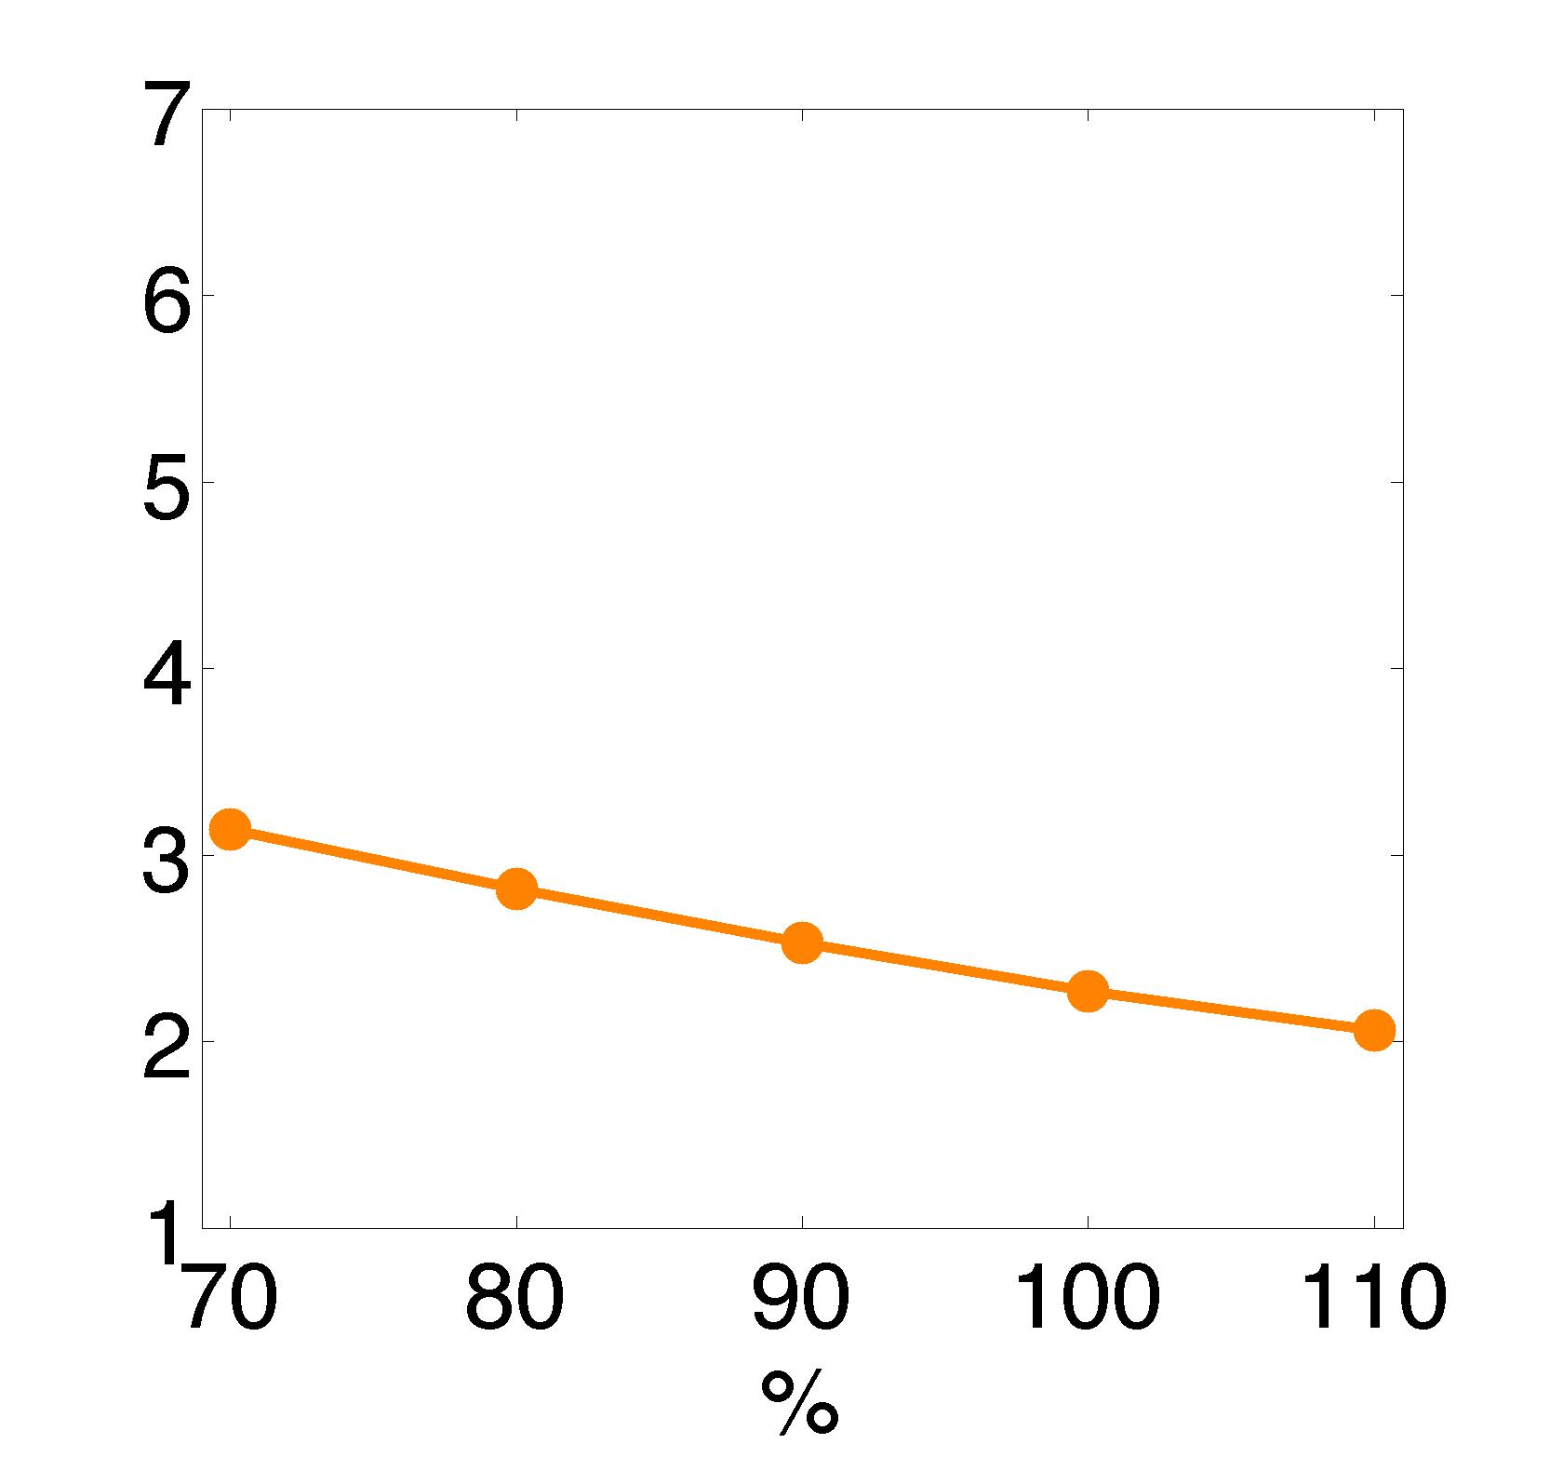
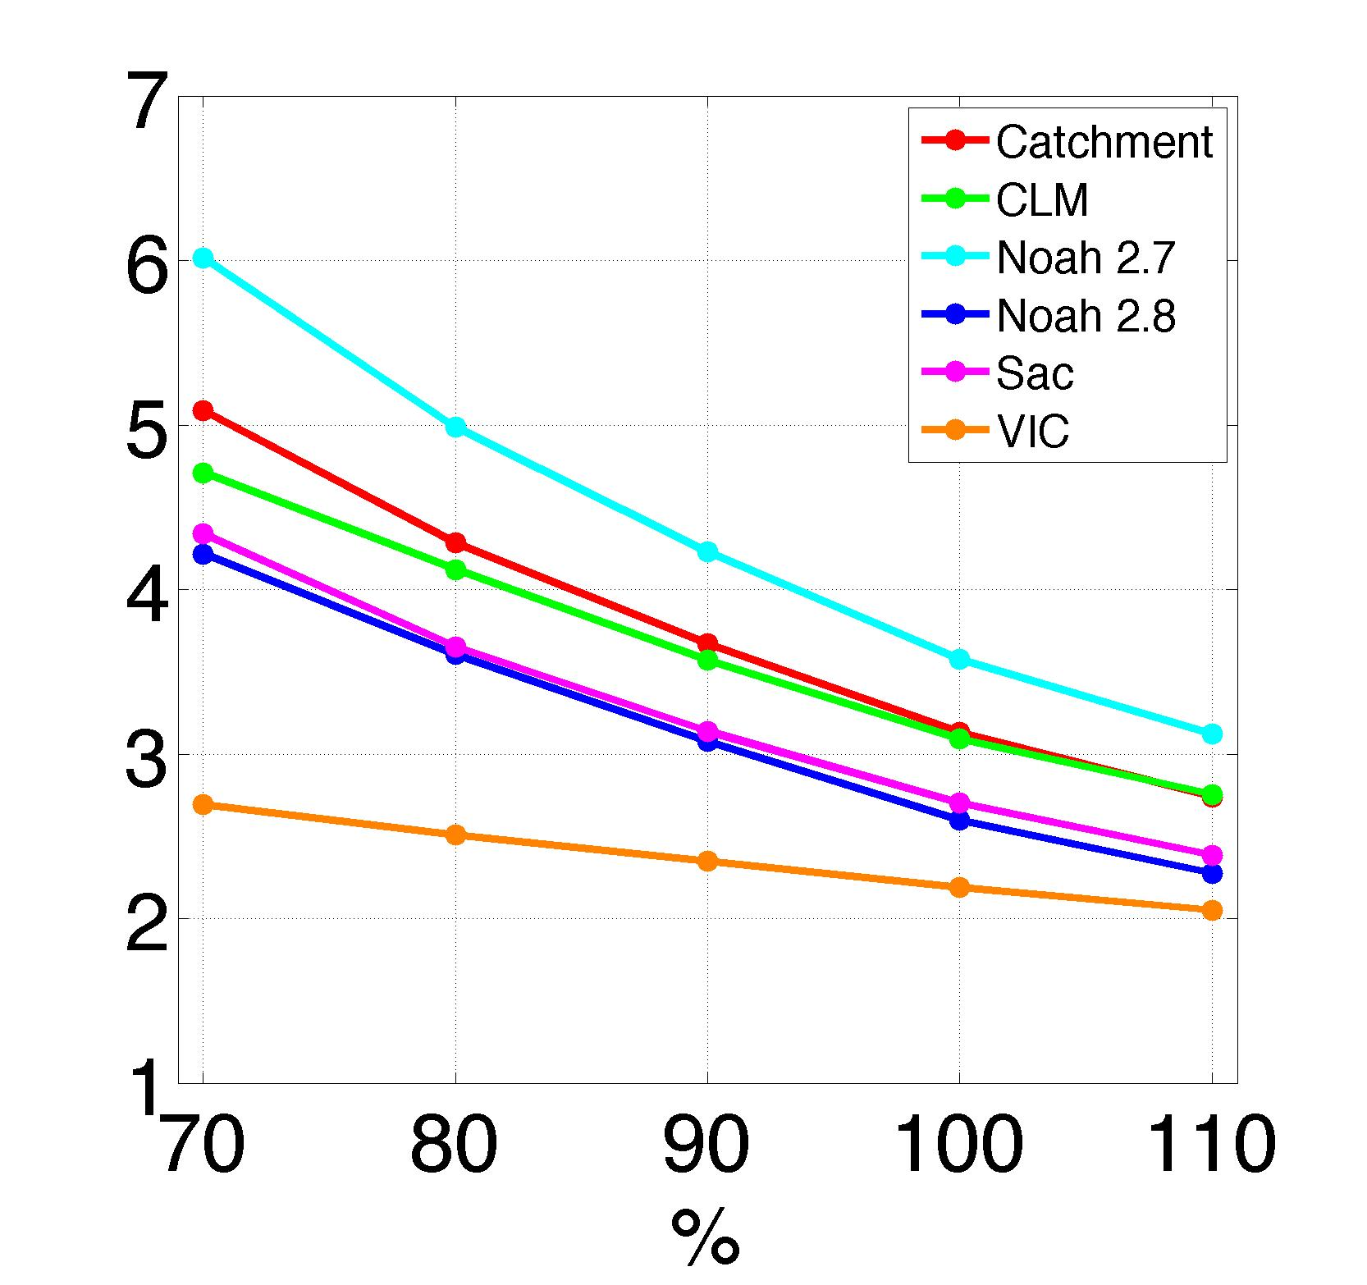
Hydrologic Sensitivities at Lees Ferry
historic flows at Lees Ferry
P elast
reference precipitation (100% = historical)
Q _{ref+1%} - Q_{ref}
Precipitation
Elasticity (ε)
=
Q_{ref}
1%
Figure from Vano et al., JHM, 2012

Slide 71
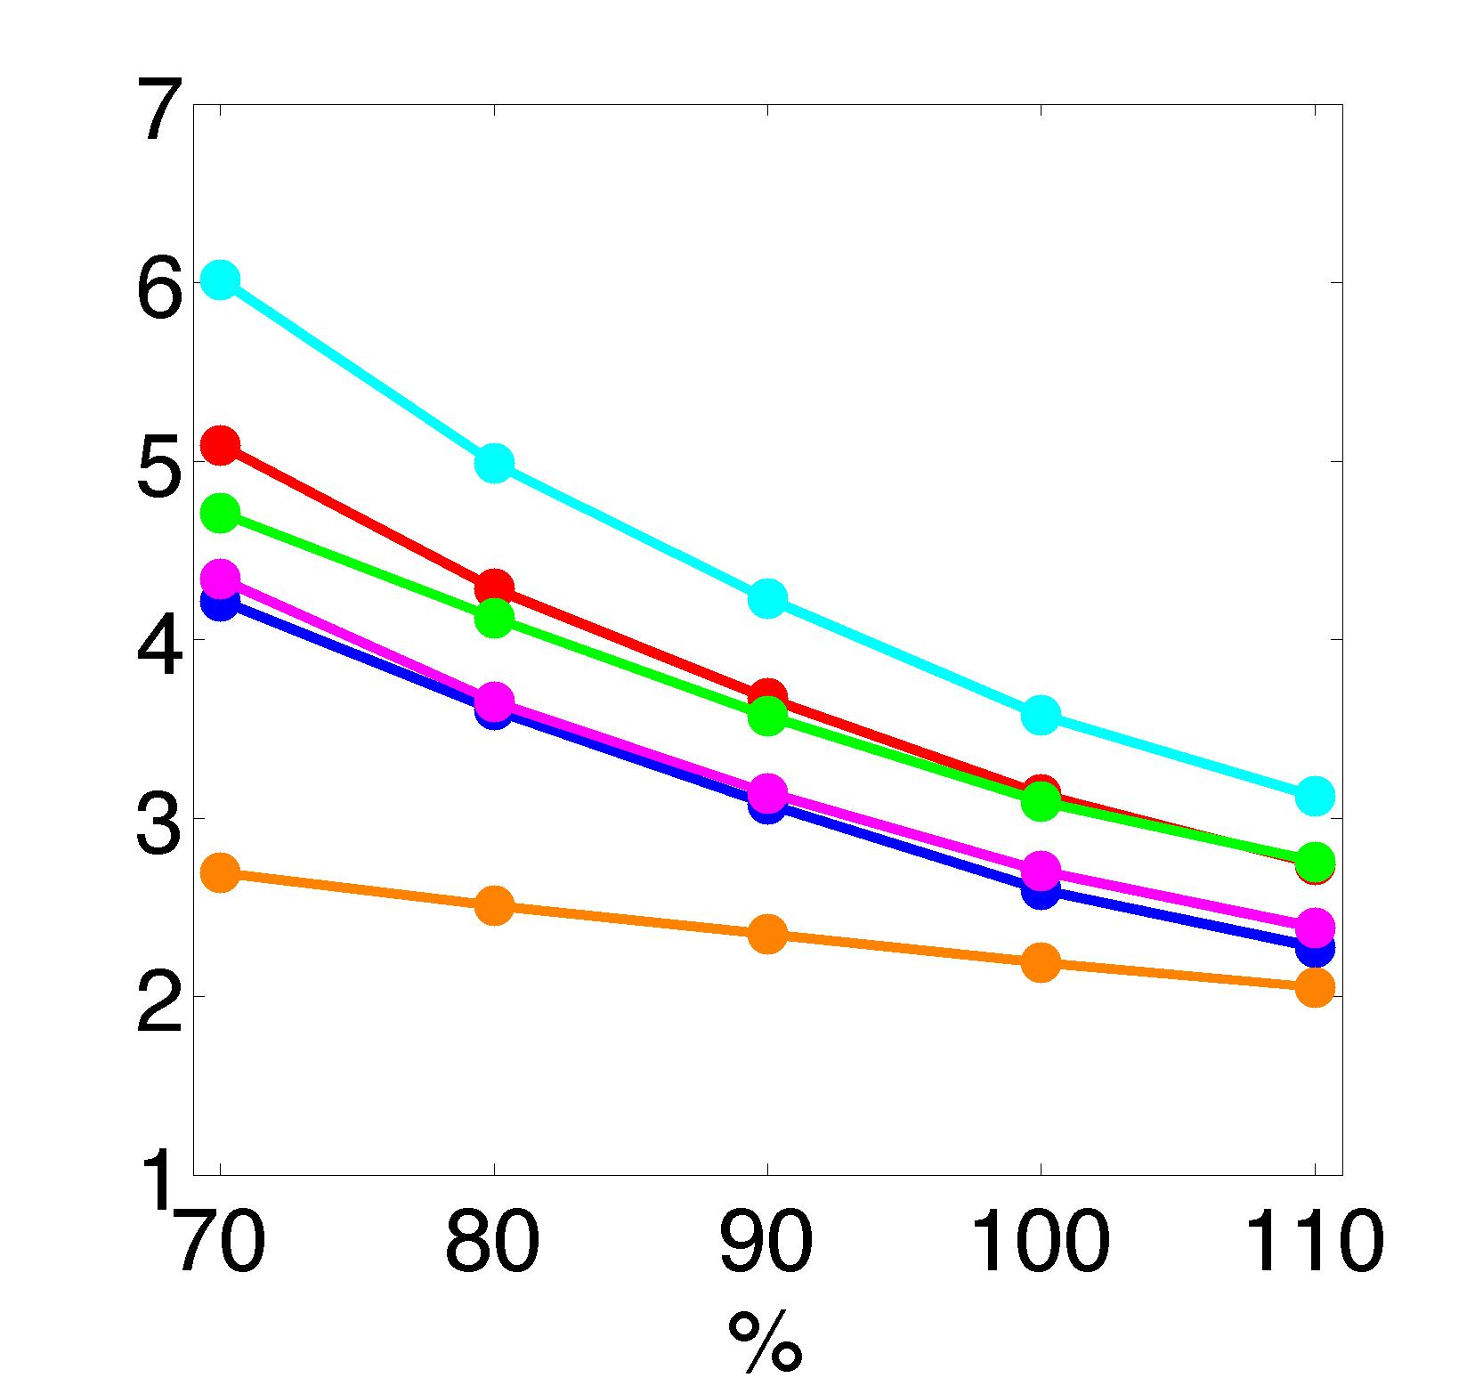
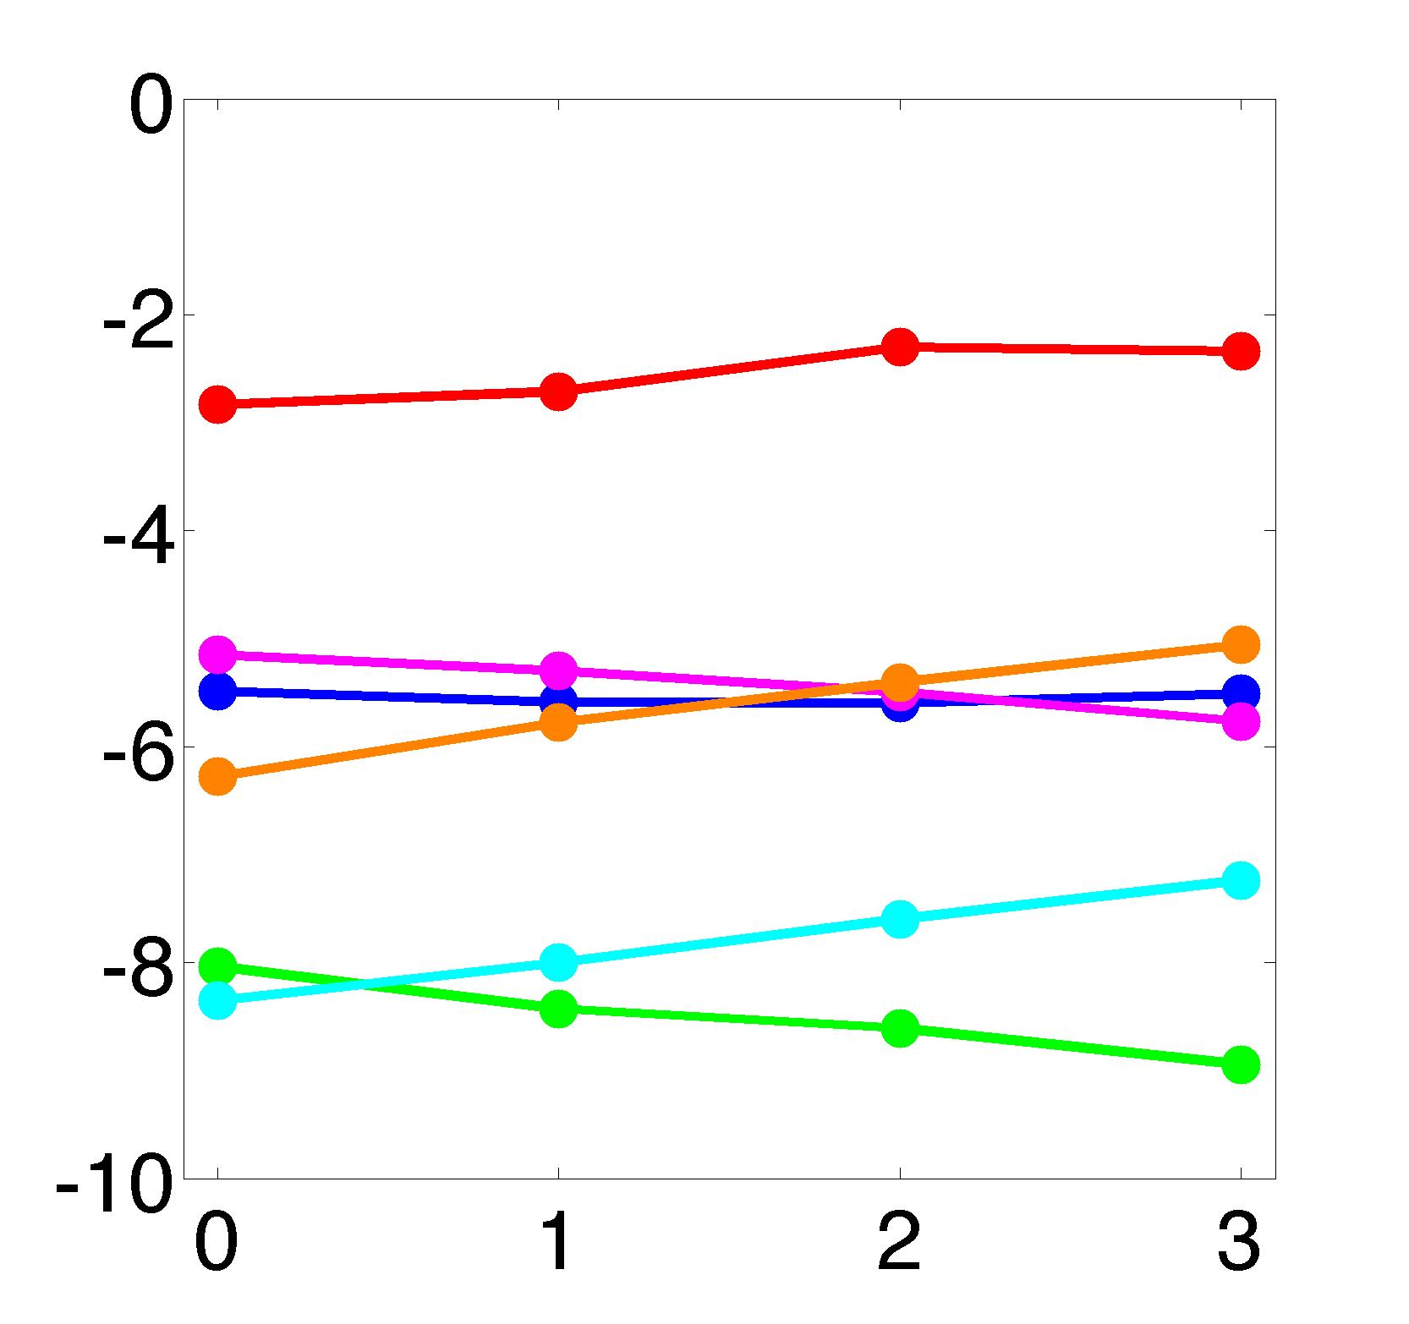
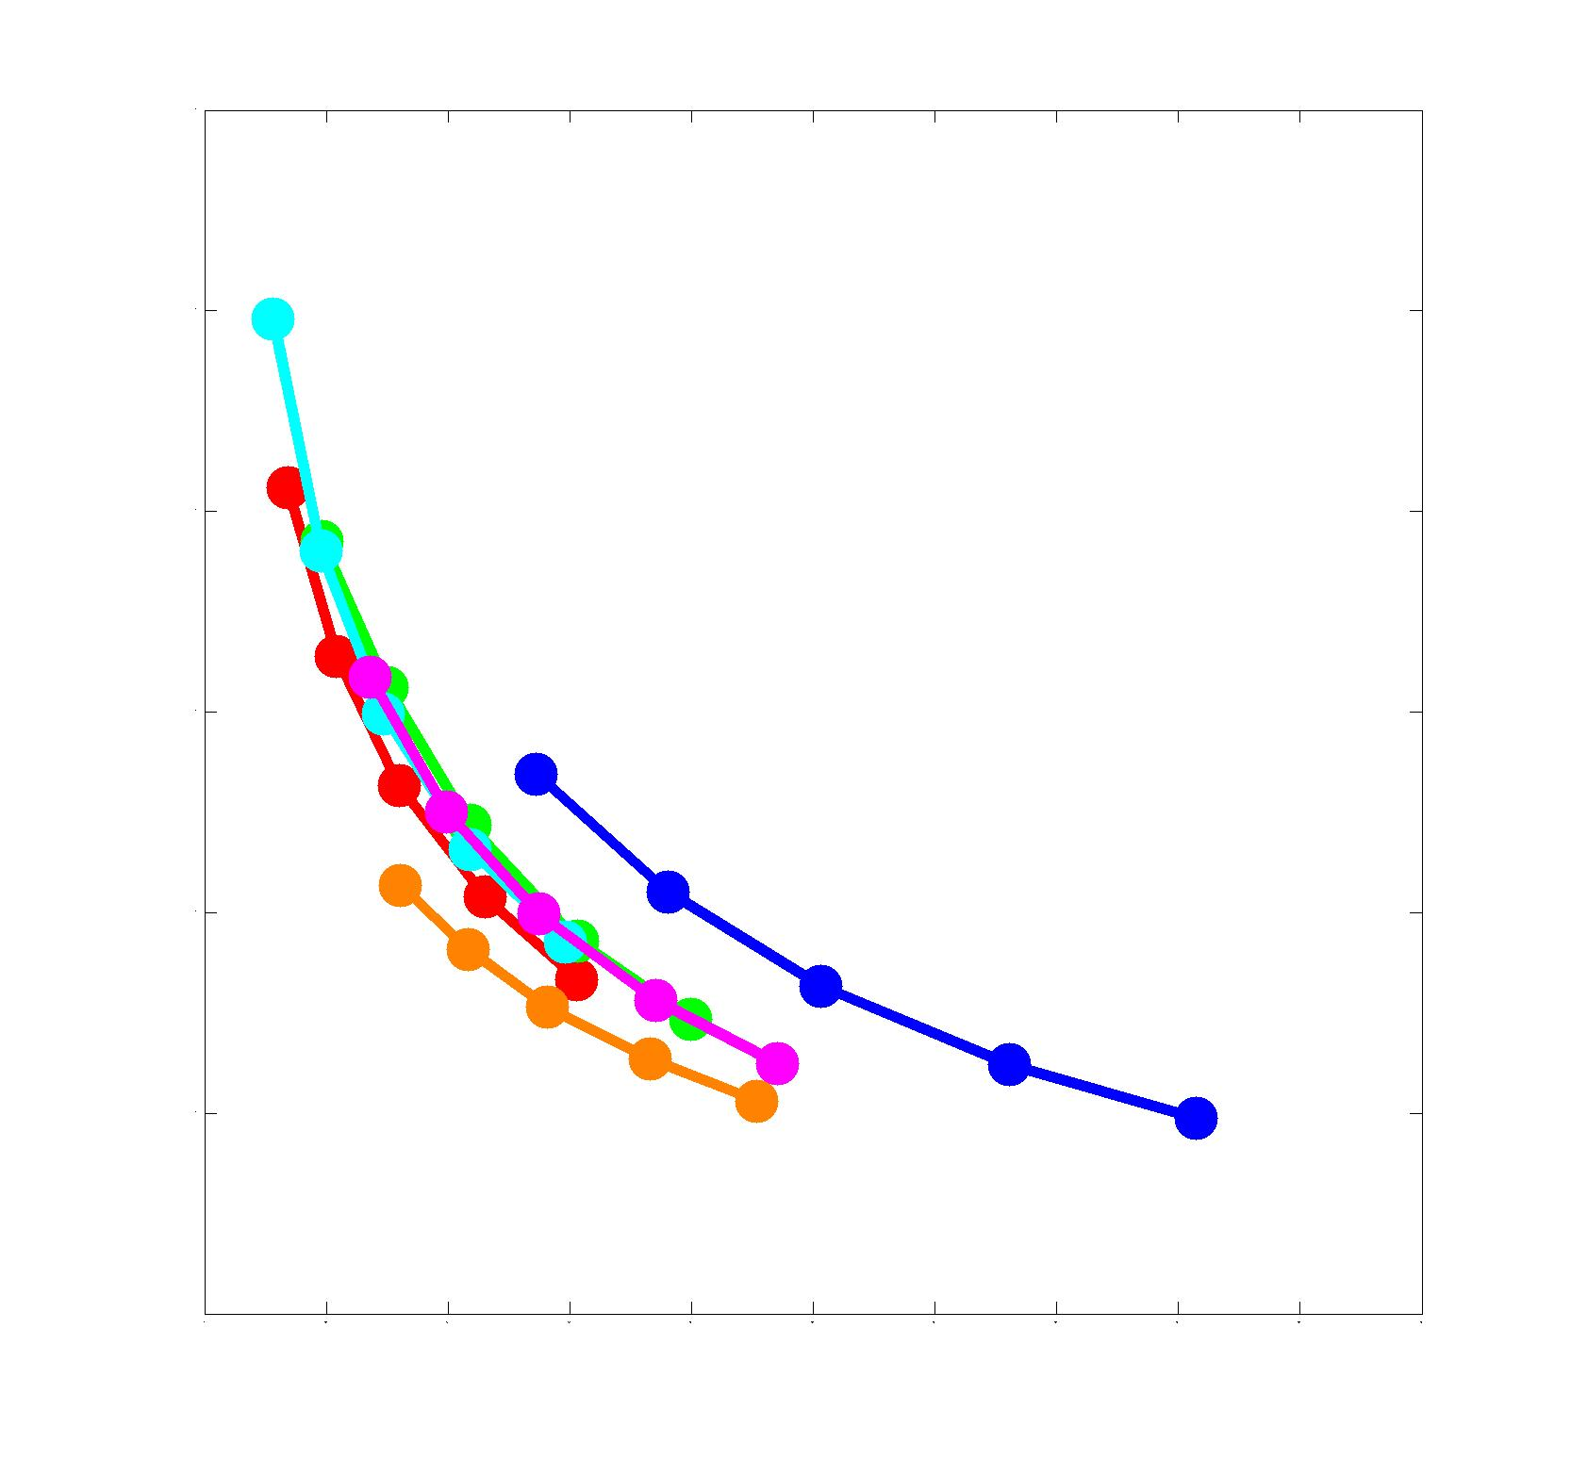
Hydrologic Sensitivities at Lees Ferry
historic flows at Lees Ferry
P elast
T sens (%)
0 200 400 600 800 1000 1200 1400
average runoff (cms)
reference temp in °C
(historical = 0)
Q _{ref+1%} - Q_{ref}
Q _{ref+0.1°C} - Q_{ref}
Precipitation
Elasticity (ε)
=
Temperature
Sensitivity (S)
=
Q_{ref}
Q_{ref}
1%
0.1 °C
Figure from Vano et al., JHM, 2012
observed
(non-parametric estimator)

Slide 72
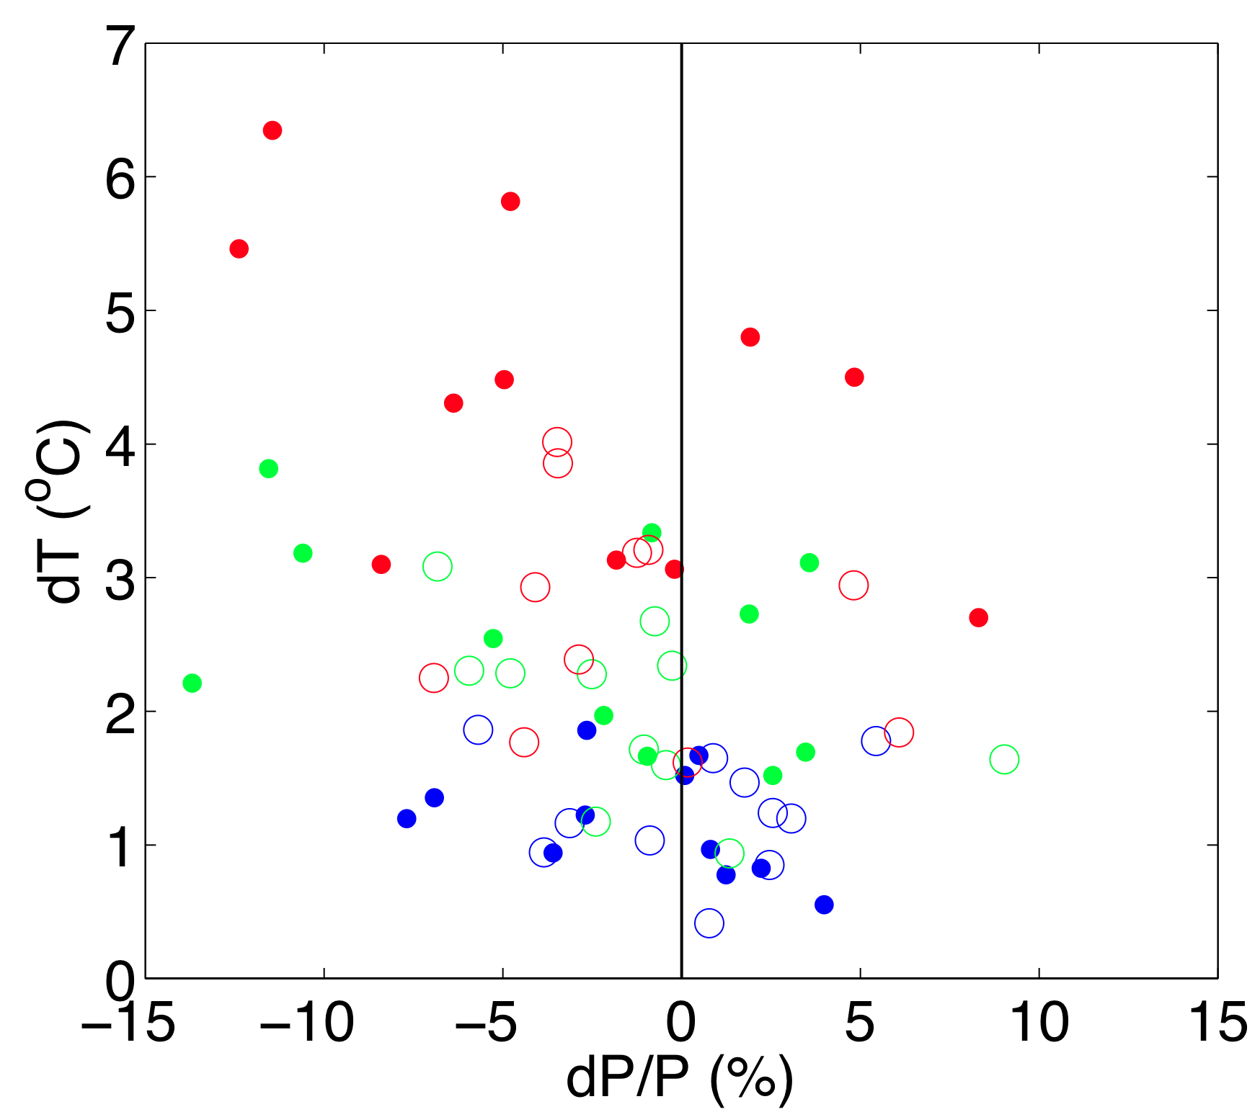
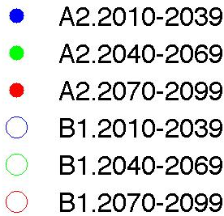
GCM Temperature and Precipitation Changes
dT_{GCM} (°C)
dP_{GCM} (%)
Figure includes Temperature (dT) and Precipitation (dP) changes for GCMs used in Chistensen and Lettenmaier (2007).

Slide 73
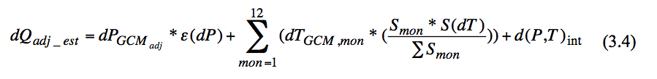
Adjustments
Ch 3, slide 73
Pre adjustments
Post adjustments
Three adjustments that improve the correlation and minimized the range of our confidence interval:
Vary ε and S values as a function of dP and dT respectively
Incorporate monthly dT and S values instead of using the annual average
(3) Adjust monthly dP values to be consistent with downscaling adjustments
Note: interaction term is zero in the Colorado basin, based on Vano et al. (JHM, 2012)

Slide 74
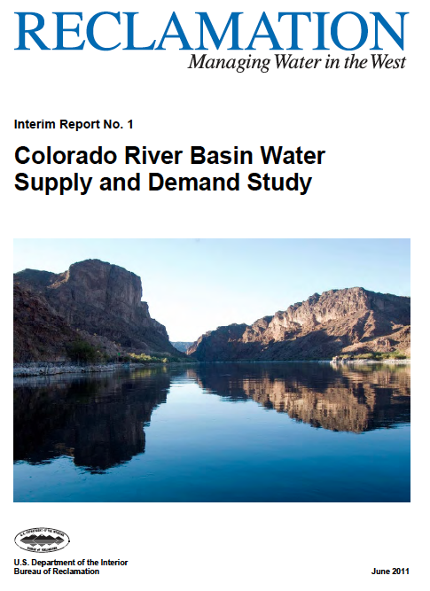
Application to 112 simulations of USBR
Ch 3, slide 74
GCMs: 16
Emission scenarios: A2, A1B, B1
Total projections: 112 (multiple runs)
Time period: 2020s, 2040s, 2080s
Spatial resolution: 1/8° (~12 km)
Land surface: Hydrologic model (VIC)
Regressions appear to contain some heteroscedasticity.

Slide 75
Extra slides

Slide 76
Traditional
approach
Sensitivity-based
approach
Global Climate
Models (P_{GCM},T_{GCM})
Global Climate
Models (ΔP_{GCM},ΔT_{GCM})
bias correcting,
downscaling
Hydrology
Models (e.g., VIC)
Hydrology
Sensitivities (ε,S)
stream routing,
bias correcting
Management
Models
Changes in
Central Tendencies
Climate Impact (e.g.,
earlier runoff, floods)
Climate Impact
(e.g., earlier runoff)

Slide 77
Traditional
approach
Sensitivity-based
approach
Impact-driven
approach
Global Climate
Models (P_{GCM},T_{GCM})
Global Climate
Models (ΔP_{GCM},ΔT_{GCM})
Global Climate
Models
bias correcting,
downscaling
pattern matching,
over threshold
identify times
Hydrology
Models (e.g., VIC)
Hydrology
Sensitivities (ε,S)
Hydrology
Models (e.g., VIC)
stream routing,
bias correcting
iterate to define threshold for extreme event
Management
Models
Changes in
Central Tendencies
Definition Extreme
Event by Mgmt
Climate Impact (e.g.,
earlier runoff, floods)
Climate Impact
(e.g., earlier runoff)
Climate Impact
(e.g., floods)

Slide 78
Preliminary results: total runoff on December 29, 1917
Variable Infiltration Capacity (VIC) model, total runoff = base flow + runoff
single grid, elevation 1250 m
1 day of meteorological forcings (Dec 29, 1917)
initial historical conditions from Dec 28 (1916-2006)
red line = event magnitude
count
1 day of weather
total runoff (mm)
Notes:
Historical conditions = state files (saved state of the model)

Slide 79
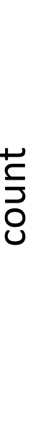
Preliminary results: total runoff on December 29, 1917
total runoff (mm)
1 day of weather
(start Dec 29)
total runoff (mm)
total runoff (mm)
total runoff (mm)
4 days of weather
(start Dec 26)
3 days of weather
(start Dec 27)
2 days of weather
(start Dec 28)
Notes:
Produced by initial states
With previous day’s conditions

Slide 80
Preliminary results: total runoff on December 29, 1917
28 days 27 days 26 days 25 days 24 days 23 days 22 days
count
21 days 20 days 19 days 18 days 17 days 16 days 15 days
14 days 13 days 12 days 11 days 10 days 9 days 8 days
7 days 6 days 5 days 4 days 3 days 2 days 1 day

Slide 81
Preliminary results: total runoff on December 29, 1917
event magnitude
initial conditions in 1917
initial conditions (1916-2006)
total runoff (mm)
days of weather
Notes:
Regardless of what the initial conditions are if you have the sequence of events from Dec 12 to Dec 29 in 1917 (17 days) you will get a event of 135 mm.
If you have the sequence
Where this trace is from 19xx,

Slide 82
Preliminary results: total runoff on December 29, 1917
event magnitude
initial conditions in 1917
initial conditions (1916-2006)
total runoff (mm)
1985
days of weather

Slide 83
Preliminary results: total runoff on December 29, 1917
event magnitude
initial conditions in 1917
initial conditions (1916-2006)
total runoff (mm)
2005
days of weather

Slide 84
Preliminary results: total runoff on December 29, 1917
event magnitude
initial conditions in 1917
initial conditions (1916-2006)
total runoff (mm)
17 days
4 days
days of weather
Notes:
Regardless of what the initial conditions are if you have the sequence of events from Dec 12 to Dec 29 in 1917 (17 days) you will get a event of 135 mm.
If you have the sequence
Where this trace is from 19xx,

Slide 85
Preliminary results: total runoff on November 12, 1999
event magnitude
initial conditions in 1999
initial conditions (1916-2006)
total runoff (mm)
days of weather

Slide 86
Preliminary results: total runoff on November 12, 1999
event magnitude
initial conditions in 1999
initial conditions (1916-2006)
total runoff (mm)
days of weather

Slide 87
What is the value of this information??

Slide 88
Quantify flood characteristics
November 12, 1999
How many days of weather are needed for X% likelihood to be greater than X?
3 days of weather
Nov 12, 1999
P = 186 mm
T = 6.2 C
Nov 11, 1999
P = 32 mm
T = 5 C
Nov 10, 1999
P = 67 mm
T = 4.3 C
Event magnitude
Initial conditions in 1999
Initial conditions (1916-2006)
days of weather
Notes:
For the sake of this example, here are the three largest floods. I increase the initial conditions
X are the thresholds
Increased to 90 years of record
Set threshold
Something about the output in these X days that is unique.
How long until X point is reached.

Slide 89
Quantify flood characteristics
November 12, 1999
How many days of weather are needed for X% likelihood to be greater than 150 mm?
3 days of weather
Nov 12, 1999
P = 186 mm
T = 6.2 C
Nov 11, 1999
P = 32 mm
T = 5 C
Nov 10, 1999
P = 67 mm
T = 4.3 C
150 mm
Event magnitude
Initial conditions in 1999
Initial conditions (1916-2006)
days of weather
Notes:
For the sake of this example, here are the three largest floods. I increase the initial conditions
X are the thresholds
Increased to 90 years of record
Set threshold
Something about the output in these X days that is unique.
How long until X point is reached.

Slide 90
Quantify flood characteristics
November 12, 1999
How many days of weather are needed for 50% likelihood to be greater than 150 mm?
3 days of weather
Nov 12, 1999
P = 186 mm
T = 6.2 C
Nov 11, 1999
P = 32 mm
T = 5 C
Nov 10, 1999
P = 67 mm
T = 4.3 C
150 mm
Event magnitude
Initial conditions in 1999
Initial conditions (1916-2006)
Runoff greater than 150 mm
1 day: 28% of years
2 days: 39% of years
3 days: 81% of years
days of weather
answer: 3 days
Notes:
For the sake of this example, here are the three largest floods. I increase the initial conditions
X are the thresholds
Increased to 90 years of record
Set threshold
Something about the output in these X days that is unique.
How long until X point is reached.

Slide 91
Quantify flood characteristics
Nov. 11, 1990 (biggest)
Nov. 12, 1999
Nov. 7, 2006
Over 150 mm
1 day: 25%
2 days: 92%
3 days: 95%
Over 150 mm
1 day: 28%
2 days: 39%
3 days: 81%
Over 150 mm
1 day: 27%
2 days: 92%
3 days: 93%
days of weather
Use several events (e.g., top 3 events) to characterize weather patterns that generate flooding.
Identify what ifs: the largest runoff event (1990) was at the high end of the ensemble of initial conditions, whereas the 3rd largest runoff event (2006) could have been larger

Slide 92
Reference past years
November 12, 1999
1995
For example:
If snow and soil conditions were similar to 1995, the event would have been 15% greater.
Future projections show a __% increase in floods similar to those in November 1999 by the 2050s.
Notes:
Highlight range of top ten events
Why I think you might be interestedManagers amazing ability to recall past years

Slide 93
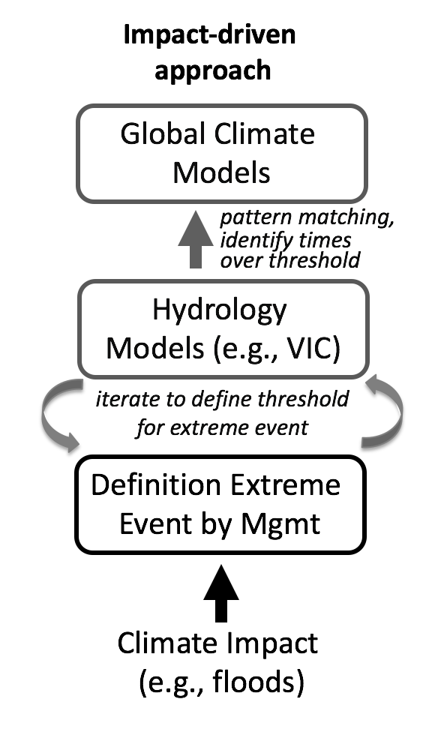
Summary
The new bottom-up approach:
encourages decision-maker engagement at the beginning and throughout
looks at system vulnerabilities before looking at climate change
quantifies the familiar, how managers talk about extreme events
Next steps:
get feedback
quantify weather patterns and their frequency in global climate models
compare with conventional approach, are extremes different?
Notes:
New bottom-up approach use the same models, but start with identifying the impact
encourages decision maker participation at - Can use this to identify how results in the future differ from those in the past.
Future directions: relevant flows in the Sauk, help in deciding which runs look at monthly streamflows for the Sauk

